Slide 1


Crop Recommendation System using Machine Learning

Slide 2

Learning Objectives
Analyze key soil nutrients (Nitrogen, Phosphorus, Potassium) and environmental factors (temperature, humidity, pH, rainfall) to determine optimal crop recommendations.
Use exploratory data analysis (EDA) and feature engineering to understand and preprocess agricultural data for model input.
Build and evaluate classification models (such as Naive Bayes and Neural Networks) to predict the most suitable crop based on input features.
Visualize data patterns and model results to gain insights into the relationships between soil/environmental parameters and crop suitability.
Summarize findings and provide actionable crop recommendations to enhance agricultural productivity and sustainability
GOAL
Source :
www.freepik.com/

Slide 3
Tools and Technology used
Python: Core programming language for data processing and modeling.
Pandas, Numpy: Data manipulation and numerical analysis.
Scikit-learn: Machine learning model development and evaluation.
Matplotlib, Seaborn: Data visualization.
Jupyter Notebook, Google Colab, VS CODE: Interactive coding and analysis environment.

Slide 4
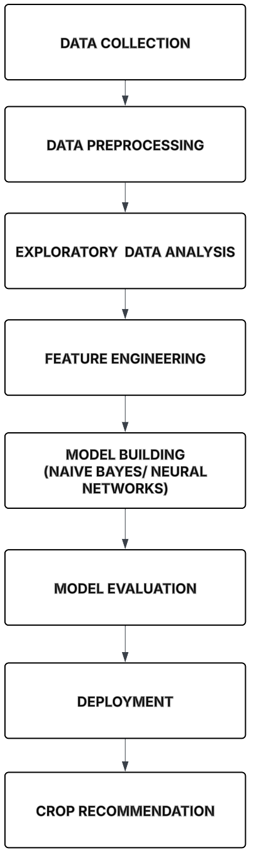
Methodology
CROP RECOMMENDATION SYSTEM

Slide 5
Problem Statement:
Farmers often struggle to select the most suitable crop for their land due to varying soil nutrients (N, P, K), pH, and environmental conditions like temperature, humidity, and rainfall.
Traditional crop selection methods rely on general knowledge or manual analysis, which may not account for specific, localized farm conditions, leading to suboptimal yields.
There is a need for a data-driven system that analyzes comprehensive soil and environmental data to recommend optimal crops, improving productivity and sustainability.
The problem involves building a machine learning model that can classify and recommend the best crop type for a given set of soil and environmental parameters.
Such a system aims to empower farmers with actionable, personalized crop recommendations, reducing guesswork and supporting better decision-making for higher yield and profitability

Slide 6
Solution:
Data Preparation: Clean and preprocess the agricultural dataset by handling missing values, normalizing numerical features (N, P, K, temperature, humidity, pH, rainfall), and encoding categorical labels like crop names. Use Pandas and Scikit-learn for efficient data transformation.
Exploratory Analysis: Perform EDA to identify correlations between soil/environmental parameters and crop types. Visualize nutrient distributions, temperature-rainfall patterns, and pH ranges using Seaborn to guide feature selection.
Model Development: Train classification models like Naive Bayes and Neural Networks to predict crop suitability. Optimize hyperparameters and address class imbalance if present in the dataset.
Evaluation & Validation: Assess model performance using metrics like accuracy, precision, and confusion matrices. Compare results across algorithms to select the best-performing model.
Deployment: Integrate the trained model into a Flask-based web interface for farmers to input soil/environmental data and receive real-time crop recommendations.

Slide 7
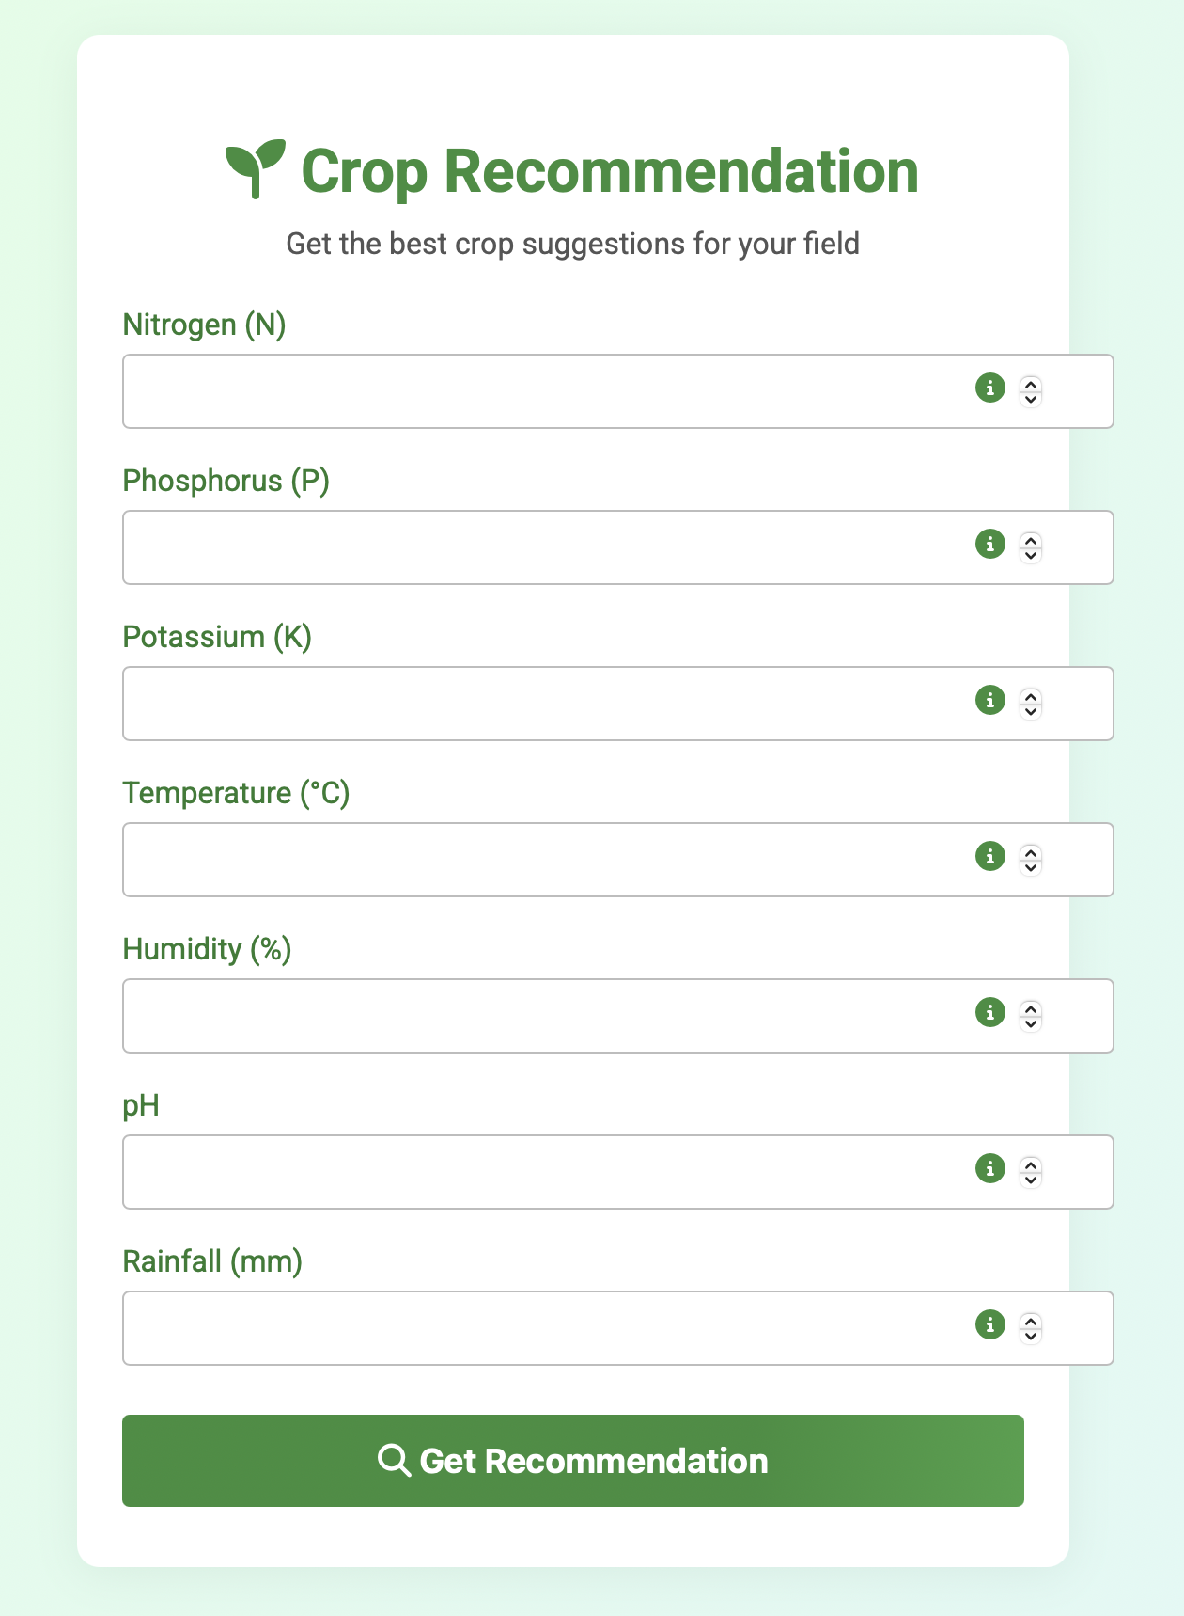
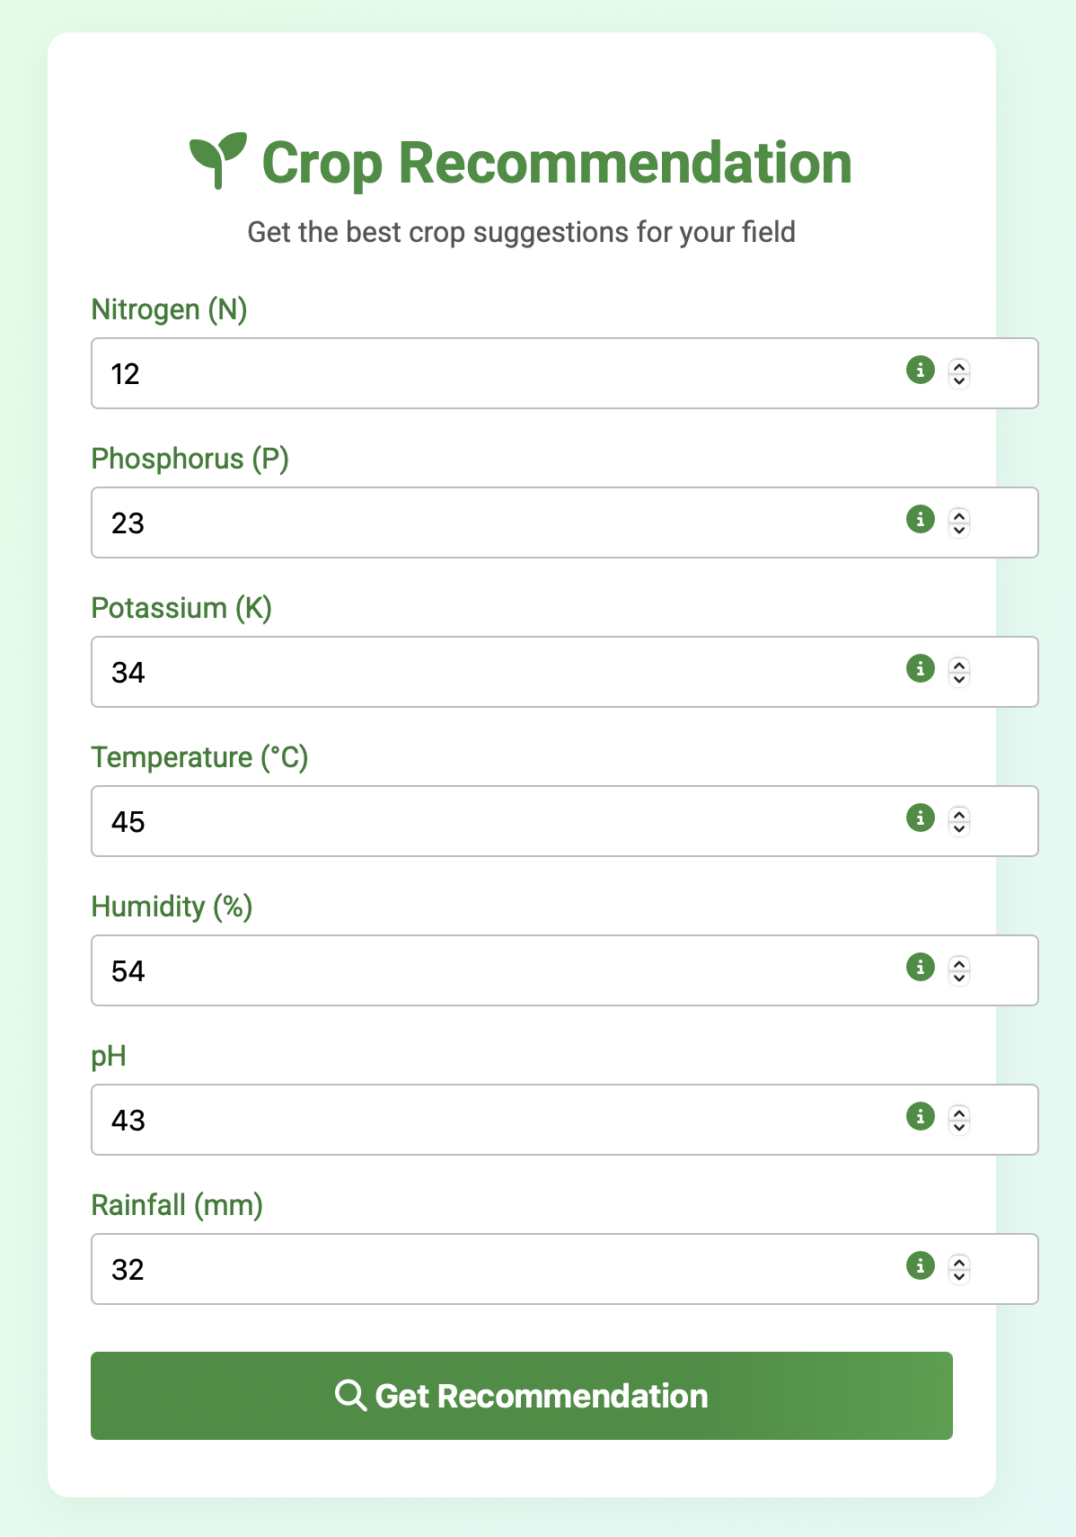
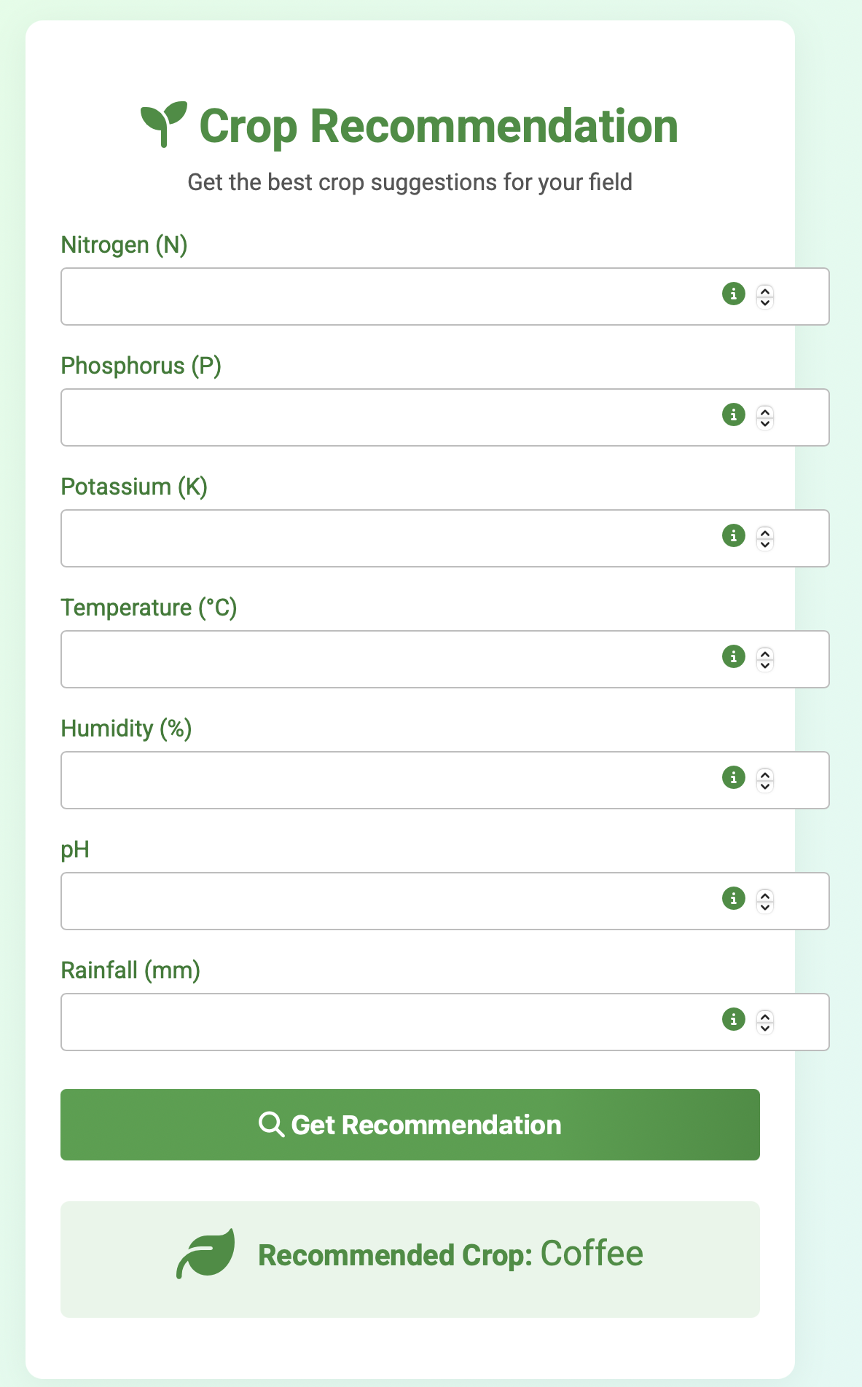
Screenshot of Output:
INPUT PAGE
VALUE PAGE
FINAL RECOMMENDATION

Slide 8
Conclusion:
The crop recommendation system effectively leverages machine learning algorithms to provide accurate and customized crop suggestions based on soil nutrients, environmental factors, and rainfall patterns, supporting data-driven agricultural decisions.
By utilizing advanced data analysis and predictive modeling, the system helps farmers maximize crop yields, reduce input costs, and improve resource efficiency, leading to higher profitability and sustainability.
The system’s adaptability to real-time and historical data enables it to respond to changing environmental conditions, reducing the risk of crop failure and enhancing resilience against unpredictable factors.
Adoption of such technology bridges the gap between traditional farming and modern precision agriculture, empowering farmers with actionable insights and promoting sustainable farming practices.
Ultimately, the crop recommendation system contributes to national food security and agricultural stability by enabling informed crop selection, minimizing environmental impact, and ensuring a reliable food supply.
The crop recommendation system effectively leverages machine learning algorithms to provide accurate and customized crop suggestions based on soil nutrients, environmental factors, and rainfall patterns, supporting data-driven agricultural decisions.
By utilizing advanced data analysis and predictive modeling, the system helps farmers maximize crop yields, reduce input costs, and improve resource efficiency, leading to higher profitability and sustainability.
The system’s adaptability to real-time and historical data enables it to respond to changing environmental conditions, reducing the risk of crop failure and enhancing resilience against unpredictable factors.
Adoption of such technology bridges the gap between traditional farming and modern precision agriculture, empowering farmers with actionable insights and promoting sustainable farming practices.
Ultimately, the crop recommendation system contributes to national food security and agricultural stability by enabling informed crop selection, minimizing environmental impact, and ensuring a reliable food supply.

